Slide 1



TRANSMISSION OF SIGNALS FROM THE MOTOR CORTEX TO THE MUSCLES
Dr. Massara Ghassan Abdulkareem
Physiology Department
College of Medicine\ University of Basrah

Slide 2
Objectives
Direct: Pyramidal pathway.
Pyramidal pathway fibers.
The pathway from motor cortex down to muscle.
Indirect : extrapyramidal tract : Red nucleus
1

Slide 3
Motor signals are transmitted
Directly from the cortex to the spinal cord through the corticospinal tract (Pyramidal)
Indirectly through multiple accessory pathways that involve
the basal ganglia, cerebellum, and various nuclei of the brain stem ( Extrapyramidal)
University of Basrah-College of Medicine-Physiology Department
2

Slide 4
Corticospinal (Pyramidal) Tract
The most important output pathway from the motor cortex
Its originates about:
30 percent from the primary motor cortex
30 percent from the premotor and supplementary motor areas
and 40 percent from the somatosensory areas posterior to the central sulcus.
University of Basrah-College of Medicine-Physiology Department
3

Slide 5
Pyramidal tract fibers
Large fibers (3%)
16 μm in diameter
originating from Betz cells
Faster conduction (70m/sec)
Ends directly in the α motor neuron
Other fibers (97%)
4μm in diameter
Slower conduction
Synapse with interneurons which in turn synapse with α or γ motor neuron.
University of Basrah-College of Medicine-Physiology Department
4

Slide 6
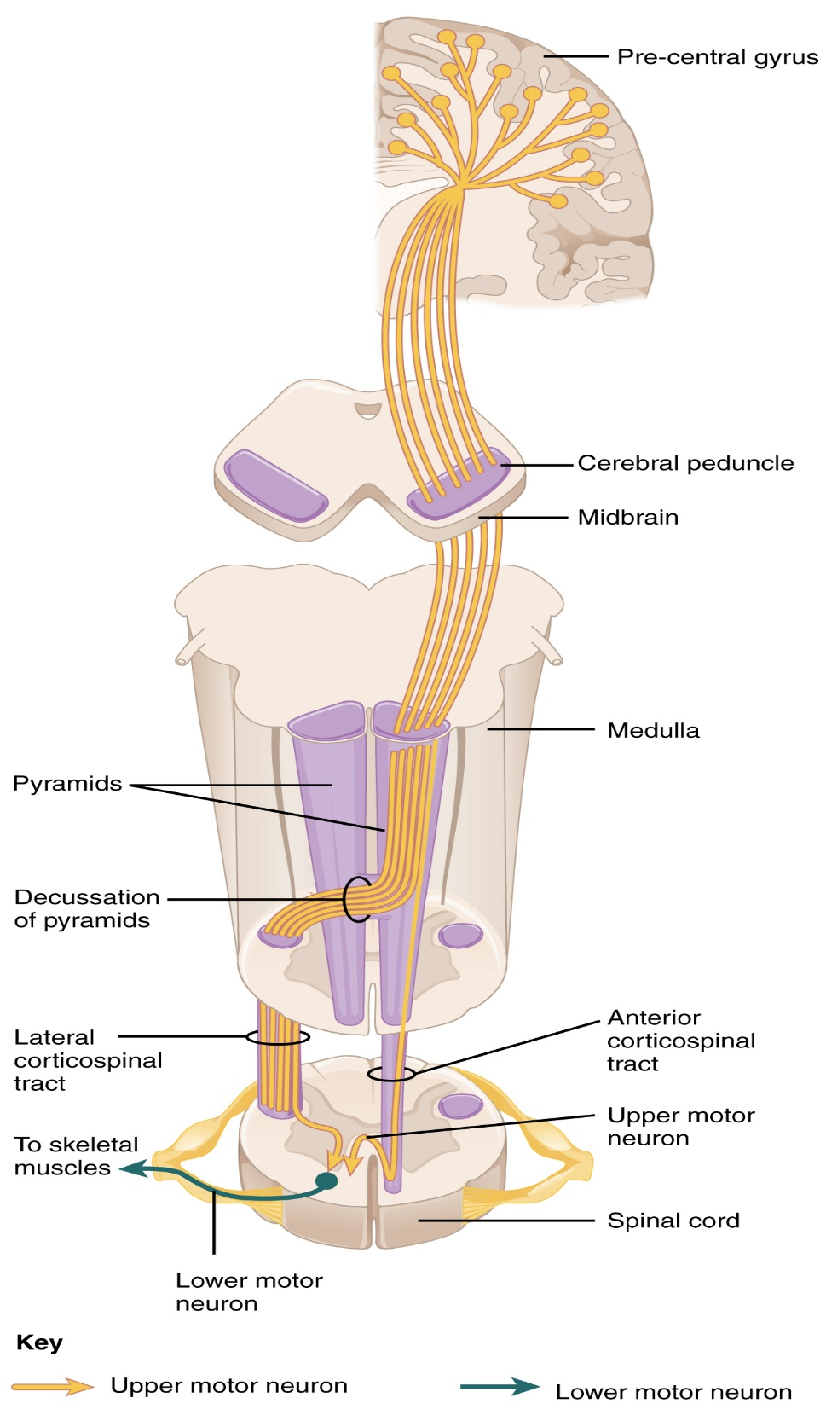
University of Basrah-College of Medicine-Physiology Department
5

Slide 7
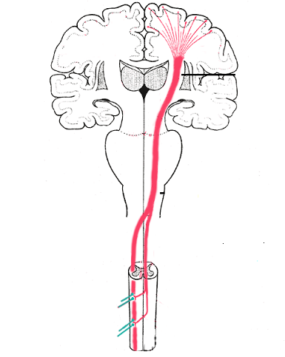
The majority of the pyramidal fibers then cross in the lower medulla to the opposite side and descend into the lateral corticospinal tracts of the cord, finally terminating principally on the interneurons in the intermediate regions of the cord gray matter
University of Basrah-College of Medicine-Physiology Department
6

Slide 8
A few of the fibers do not cross to the opposite side in the medulla but pass ipsilaterally down the cord in the (ventral or anterior corticospinal tracts.)
Many, if not most, of these fibers eventually cross to the opposite side of the cord either in the neck or in the upper thoracic region.
University of Basrah-College of Medicine-Physiology Department
7

Slide 9
“Extrapyramidal” System
_All descending tracts other than the pyramidal tract called extrapyramidal tracts
_Pyramidal and extrapyramidal tracts should function together for smooth activity
_Background tone, posture, equilibrium etc., are maintained by extrapyramidal system
_Voluntary activity is controlled by pyramidal system
University of Basrah-College of Medicine-Physiology Department
8

Slide 10
Extrapyramidal fibers arise from
1. Cerebral cortex
University of Basrah-College of Medicine-Physiology Department
9

Slide 11
2. Subcortical structures
And others like tectal nucleus and olivary nucleus
Basal Ganglia
Reticular formation of brain stem
vestibular nuclei
Red
Nucleus
University of Basrah-College of Medicine-Physiology Department
10

Slide 12
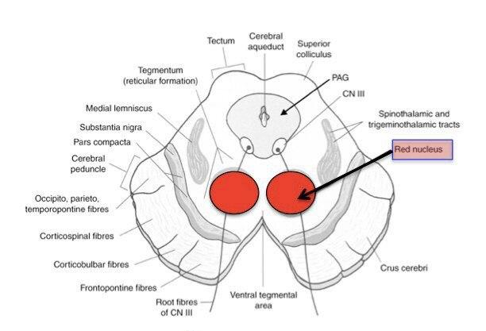
Red Nucleus
University of Basrah-College of Medicine-Physiology Department
11

Slide 13
THE RED NUCLEUS
Structure in the rostral midbrain involved in motor coordination
SERVES AS AN ALTERNATIVE PATHWAY FOR TRANSMITTING CORTICAL SIGNALS TO THE SPINAL CORD
University of Basrah-College of Medicine-Physiology Department
12

Slide 14
Corticorubrospinal
Fibers from primary motor cortex synapse with large neurons in magnocellular portion of red nuceus → corticorubral tract
Fibers from red nucleus to spinal cord → rubrospinal tract
Which crosses to the opposite side in the lower brain stem and follows a course immediately adjacent and anterior to the corticospinal tract .
University of Basrah-College of Medicine-Physiology Department
13

Slide 15
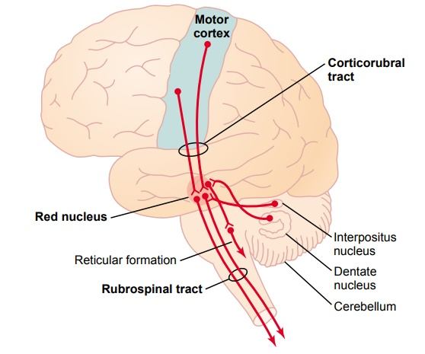
University of Basrah-College of Medicine-Physiology Department
14

Slide 16
Functions of Corticorubrospinal tract
It has a representation of all the muscles of the body, as is true of the motor cortex.
The representation of the different muscles is far less developed than in the motor cortex (it is relatively small in human beings)
The corticorubrospinal pathway serves as an accessory route for transmission of relatively discrete signals from the motor cortex to the spinal cord.
University of Basrah-College of Medicine-Physiology Department
15

Slide 17
When the corticospinal fibers are destroyed but the corticorubrospinal pathway is intact,
discrete movements can still occur, except that the
movements for fine control of the fingers and hands
are considerably impaired.
University of Basrah-College of Medicine-Physiology Department
16

Slide 18
Recap
1. Pathways of motor transmission : direct Pyramidal and indirect Extrapyramidal .
2. corticospinal tract :The majority will cross in the lower medulla to the opposite side and descend into the lateral corticospinal tracts of the cord, terminating on the interneurons in the intermediate regions of the cord gray matter.
few of the fibers do not cross to the opposite side in the medulla but pass ipsilaterally down the cord in the (ventral or anterior corticospinal tracts.)
3. Red nucleus: Structure in the rostral midbrain involved in motor coordination, transmission of discrete signals from the motor cortex to the spinal cord.
17

Slide 19
Thank You

